Slide 1
Office 365 Development
July 2014

Slide 2
O3657-1 Deep dive into building standalone AngularJS web applications with Bootstrap for Office 365
Speaker
Speaker

Slide 3

Agenda
Working with Bootstrap
Introduction to AngularJS
Directives and Modules
Routes, Views and Controllers
Angular Services

Slide 4
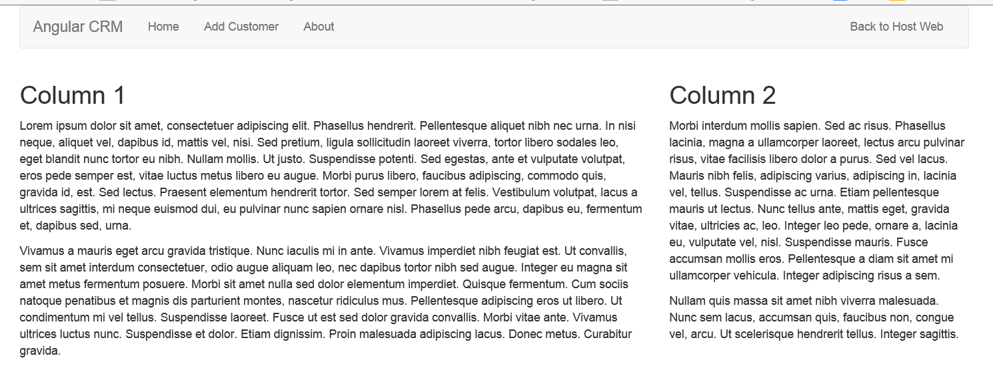
What is Bootstrap?
A CSS-based Framework for faster web development
Predefined classes for page layout with navbars, columns, forms, tables, etc.
Provides much faster way to create HTML-based user interfaces
Very good for creating mobile-friendly layouts

Slide 5
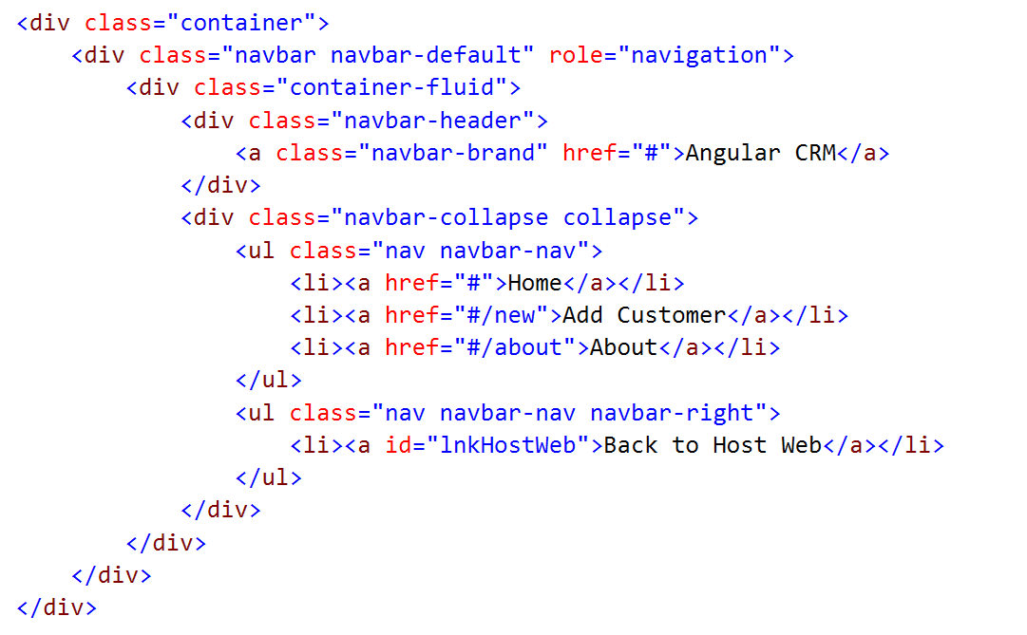
Creating a Navbar using Bootstrap

Slide 6
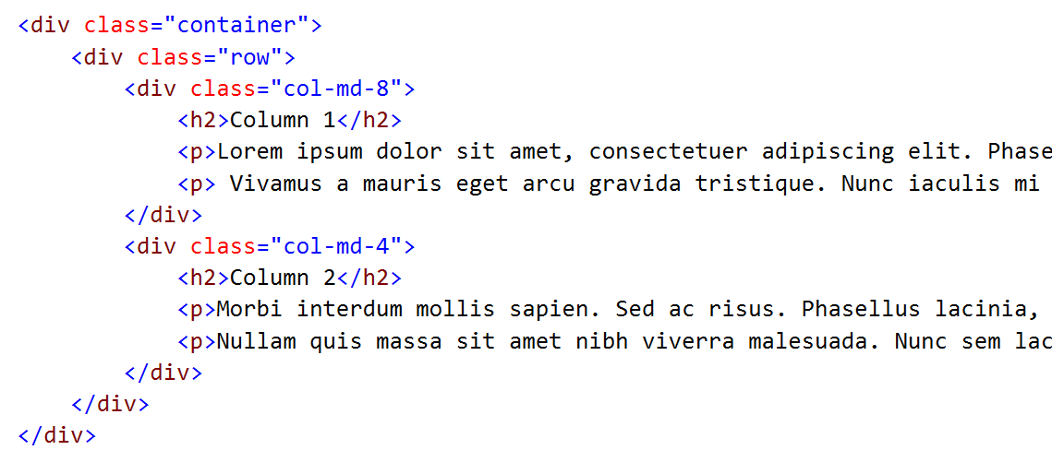
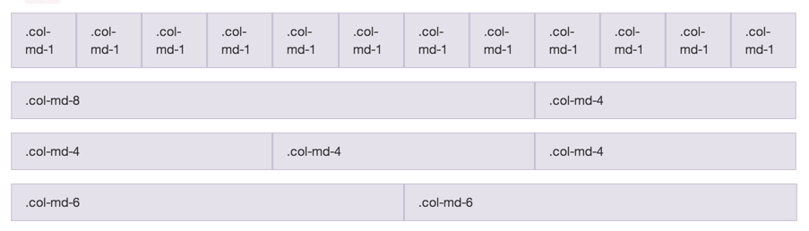
Grid Layout

Slide 7
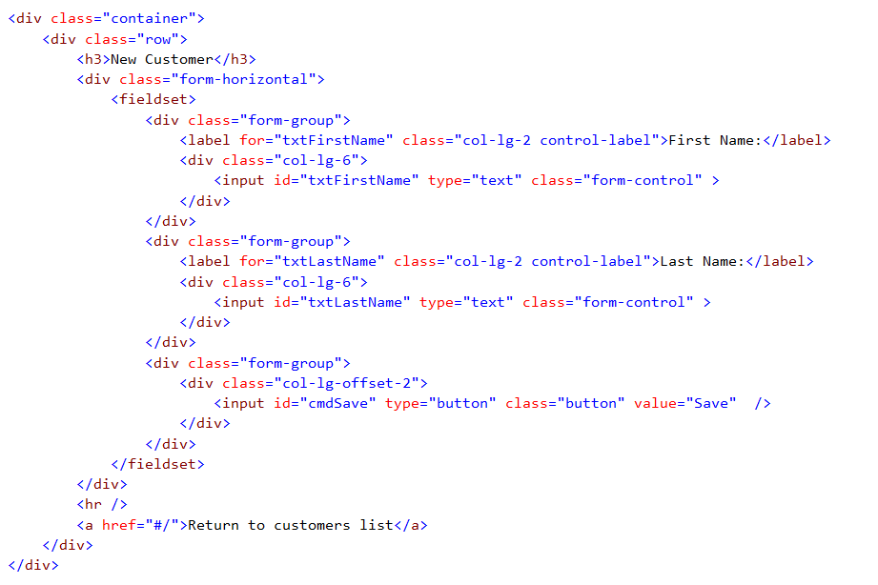
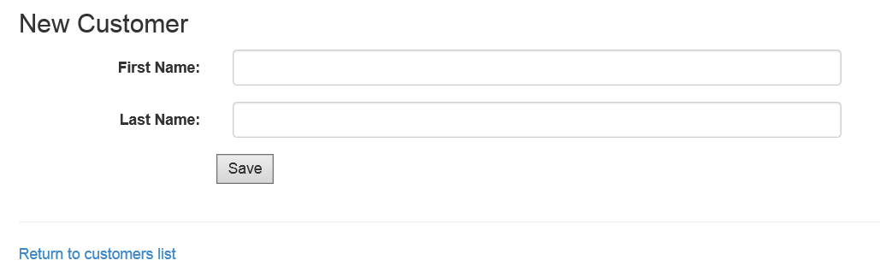
Bootstrap Forms

Slide 8
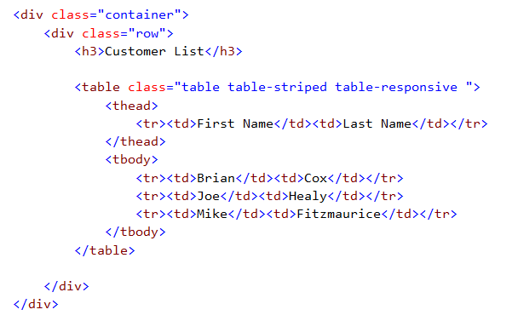
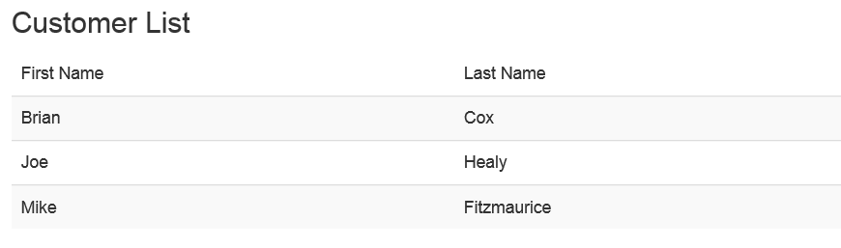
Bootstrap Table Classes

Slide 9
demo
Creating a User Interface using Bootstrap

Slide 10
Introduction to AngularJS

Slide 11

Introducing AngularJS
What is AngularJS?
A JavaScript framework for building web applications
Based on Single-Page Application (SPA) model
Implements Model-View-Controller (MVC) Pattern
Check out the official site at http://angularjs.org/
Why is AngularJS so popular these days?
True framework instead of patchwork of libraries
Strong separation of concerns

Slide 12
Angular JS Features
Directive
A shared unit of declarative functionality
Module
A container for a reusable unit of code
Controller
A JavaScript functions which processes incoming requests
View
An HTML template that serves as a partial view on a page
Model
JavaScript object containing domain-specific data prepared by controller
Object properties declaratively bound to HTML elements in the view
Service
Built-in Angular services include $http, $window and $route
Custom services used to write code which is shared across controllers

Slide 13
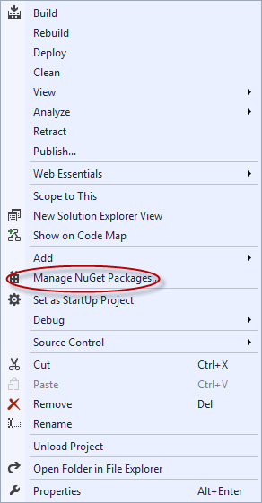
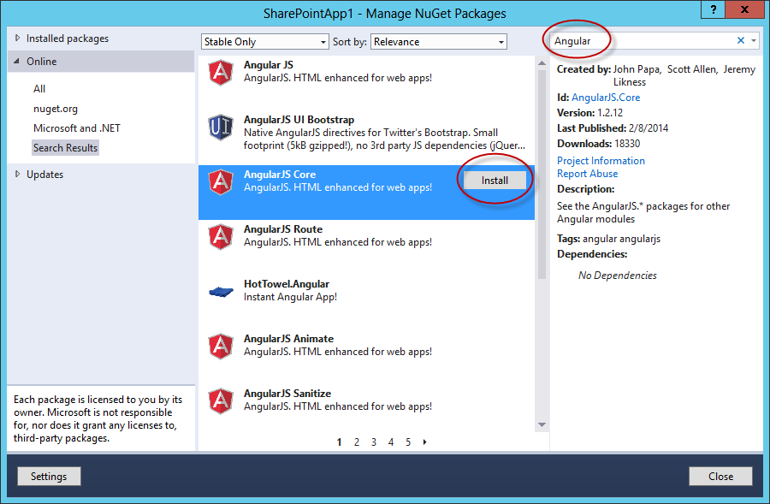
Adding Angular JS to an App
1. Manage NuGet Packages
2. Search for “Angular”
3. Install Angular JS Core

Slide 14
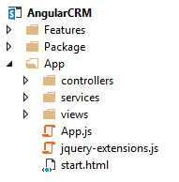
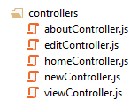

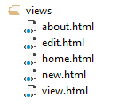
SharePoint App Project Structure
All application code maintained in App folder
App start page implemented using start.html
App initialization code maintained in app.js
Child folders added for controllers, services and views

Slide 15
demo
Using AngularJS in a Sharepoint-hosted App Project

Slide 16
Directive and Modules

Slide 17
Angular Directives
AngularJS includes several built-in Directives
Directives created with custom attributes in HTML5
Custom attributes in HTML5 start with data-
Angular Directives start with data-ng or ng-
You can use data-ng-app or ng-app
You can use data-ng-controller or ng-controller
You can use data-ng-click or ng-click

Slide 18
Key Angular Directives
data-ng-app: initialize the Angular app
data-ng-controller: designate controller scope
data-ng-view: define placeholder for dynamic views
data-ng-bind: one-way binding of HTML element to model
data-ng-model: two-way binding of HTML element to model
data-ng-repeat: create for-each loop
data-ng-click: handle click event.
data-ng-cloak: prevents view from displaying during start up
data-ng-hide: shows or hides an HTML element
data-ng-href: creates Angular-compliant anchor tags
data-ng-src: creates Angular-compliant img tags

Slide 19
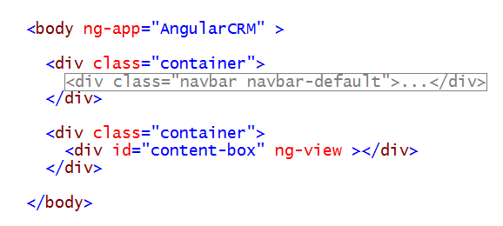
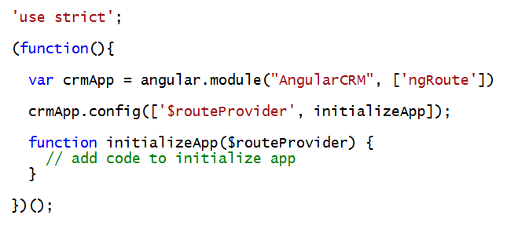
Understanding Modules
Module represents a container of code
AngularJS provides several built-in Modules
Third parties libraries often created using Modules
Named module can be created for app
App module named using ng-app Directive
App module initialized using angular.module function

Slide 20
demo
Adding Angular Directives to the Start Page of a SharePoint-hosted App

Slide 21
Routes, Views and Controllers

Slide 22
Routes, View Template and Controllers
What are Routes?
Route represents endpoint in the app's route map
Route configured with View template and Controller
What is a View Template?
HTML fragment in .html file which acts as partial view
HTML in view template often created using Directives
What is a controller?
JavaScript function which provides view logic
Controller creates and passes model to View Template

Slide 23
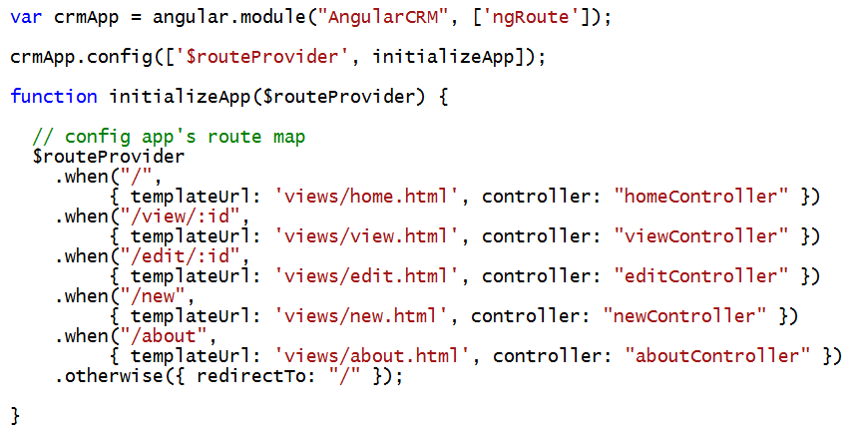
Defining Routes
Steps to defining route map for an app
Add Angular JS Route NuGet Package
Reference the ngRoute Module
Define routes using the injected $routeProvider object

Slide 24
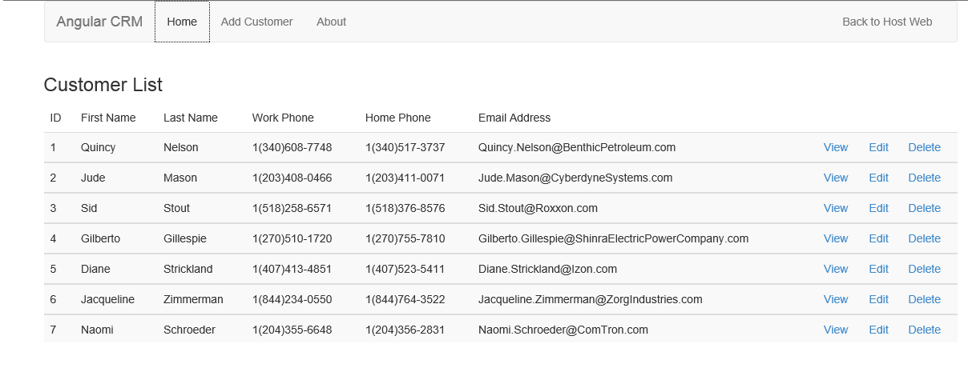
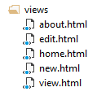
Dynamically Loading View Templates
View placeholder element defined using ng-view attribute
View templates are loaded into view placeholder element

Slide 25
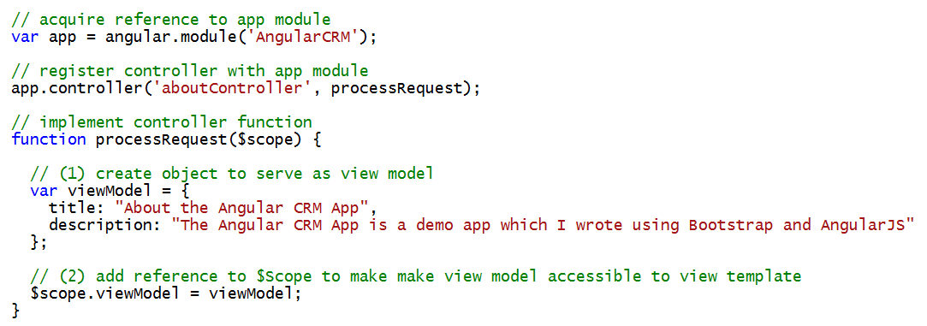
Understanding Controllers
Controllers are implemented using JavaScript functions
Controller registered using controller function on app module
Controller typically creates object to serve as view model
Controllers makes view model accessible through $scope object

Slide 26
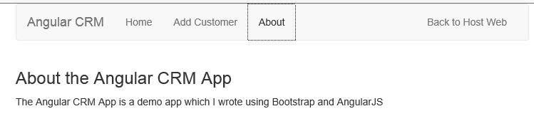
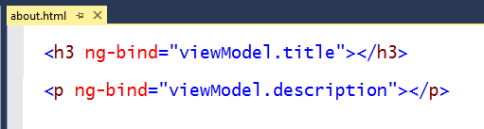
Understanding View Templates
View Templates are implemented using HTML
You add HTML and CSS as usual
Directives are added to enable data binding to model
Directives are added to wire up event handlers in controller
Data binding directives
ng-bind: used to create one-way, read-only binding
ng-model: used to create two-way, read-write binding

Slide 27
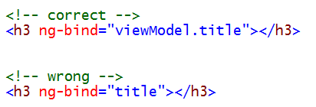
Programming $scope in Controllers & Views
Rule of thumb in dealing with $scope
Treat $scope as write-only in controllers
Treat $scope as read-only in templates
Common misconception that $scope is the model
In truth, $scope is not the model
Instead, $scope references a separate object which is the model
Don’t bind elements directly to $scope properties
Unexpected behavior occurs in child scopes
Instead, create separate JavaScript object for model
If ng-bind or ng-model value doesn't have a dot (.) - you’re doing it wrong

Slide 28
Filters
Perform common operations on data bound elements
Takes the form of {{ expression | filter }}
<div ng-app="App">
<div>
<input type="text" data-ng-model="firstName"/>
<div>{{firstName | uppercase}}</div>
</div>
</div>
Display data in all caps

Slide 29
Key Filters
Format
currency
date
number
Displaying data sets
orderBy
limitTo
String manipulation
uppercase
lowercase

Slide 30
demo
Creating a Routing Scheme with Controllers and View Templates

Slide 31
Angular Services

Slide 32
Service Components included with AngularJS
Angular includes many built-in service components
This tables lists some of the more commonly used services
Service | Purpose
$http | used to communicate with the remote HTTP servers using XMLHttpRequest object
$location | used to retrieve the URL in the browser address bar
$log | safely writes the message into the browser's console
$q | promise/deferred implementation
$window | reference to the browser's window object
$anchorScroll | scrolls to the related element
$filter | used for formatting data displayed to the user
$route | used for deep-linking URLs to controllers and views
$routeParams | allows you to retrieve the current set of route parameters

Slide 33
Custom Services in Angular
What type of code should be written in a service?
Any code which is to be shared across controllers
Any code which calls to servers across the network
How do you create a service?
Call factory method on App Module object to create a new service
How do you use the service from a controller?
Pass it by name to any controller function to trigger code injection
Wingtip.App.factory("welcomeService", function ($rootScope) {
var welcomeService = {};
welcomeService.greet = function () {
alert("Hi!");
};
return welcomeService;
});
Wingtip.App.controller("myCtrl", ["$scope", "welcomeService",
function contactsCtrl($scope, welcomeService) {
welcomeService.greet();
}]
);

Slide 34
Best Practices with Services and Controllers
Controllers should never reference the DOM
DOM manipulation done using custom Directives
Controllers should define view behavior
What happens when user clicks Filter button?
What happens when user clicks Save button?
Controllers should not contain any data access code
Code to call across network should be written in service(s)
Services should rarely reference the DOM
Exception is service which interacts with user using modal dialog
Service logic should be completely decoupled from all views

Slide 35
Controller Processing Flow
Incoming request routed to Controller using app's route map
Controller calls data access function provided by custom service
Custom service calls across network to fetch SharePoint list data
Custom service returns SharePoint list data to Controller
Controller uses SharePoint list data to create model
Controller passes model to View Template using $scope
View Template binds to model data using Directives
View Templates renders HTML which is returned to client
Incoming Request
Controller
Custom Service
SharePoint REST API
SharePoint
List Data
View Model
HTML
Response
View Template

Slide 36
Custom Service Example: wingtipCrmService

Slide 37
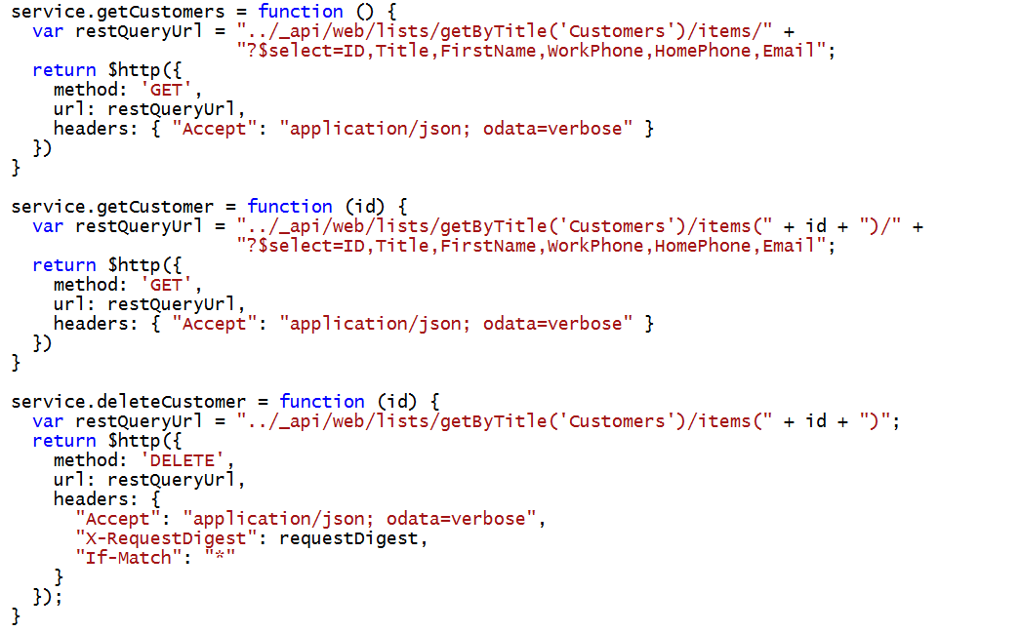
Accessing the SharePoint REST API

Slide 38
demo
Adding a Custom Service to Access a SharePoint List

